Slide 1
Risk Management

Slide 2
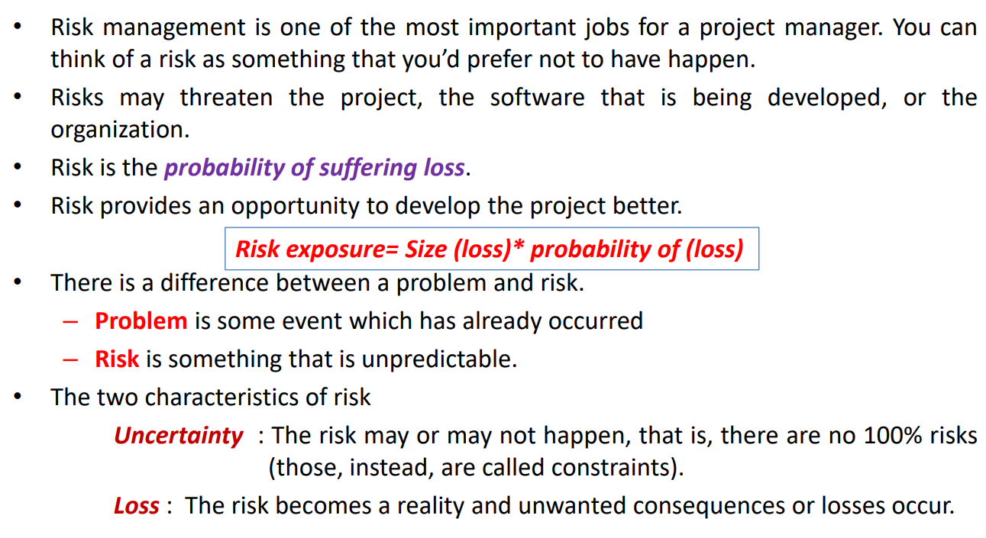
Risk
Risk always involves two characteristics:
Uncertainty—the risk may or may not happen; that is, there are no 100% probable risks
Loss—if the risk becomes a reality, unwanted consequences or losses will occur .
When risks are analyzed, it is important to quantify the level of uncertainty and the degree of loss associated with each risk.
To accomplish this, different categories of risks are considered:
Project risks
Technical risks
Business risks

Slide 3
Risks
Project risks threaten the project plan.
That is, if project risks become real, it is likely that project schedule will slip and that costs will increase.
Project risks identify potential budgetary, schedule, personnel (staffing and organization), resource, customer, and requirements problems and their impact on a software project.
Technical risks threaten the quality and timeliness of the software to be produced.
If a technical risk becomes a reality, implementation may become difficult or impossible.
Technical risks identify potential design, implementation, interface, verification, and maintenance problems.
In addition, specification ambiguity, technical uncertainty, technical obsolescence, and "leading-edge" technology are also risk factors.
Technical risks occur because the problem is harder to solve than we thought it would be.
.

Slide 4
Business risks threaten the viability of the software to be built.
Business risks often jeopardize the project or the product. Candidates for the top five business risks are
(1) building a excellent product or system that no one really wants (market risk),
(2) building a product that no longer fits into the overall business strategy for the company (strategic risk),
(3) building a product that the sales force doesn't understand how to sell,
(4) losing the support of senior management due to a change in focus or a change in people (management risk), and
(5) losing budgetary or personnel commitment (budget risks). It is extremely important to note that simple categorization won't always work. Some risks are simply unpredictable in advance.

Slide 5
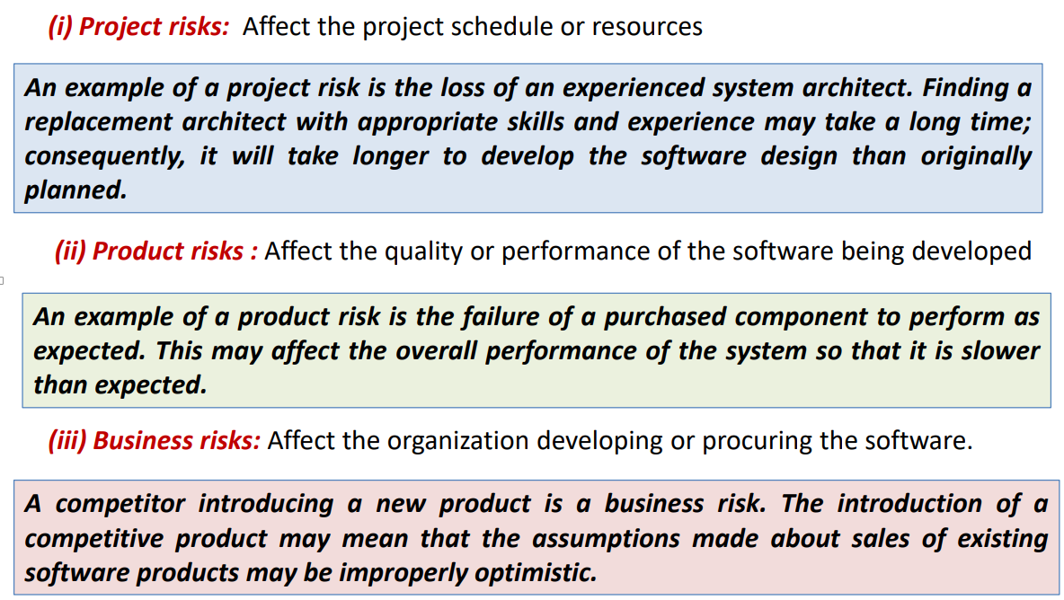

Slide 6
Business risk can be further categorized into the following:
Market risk : Building an excellent product or system that no one really wants.
Strategic risk: Building a product that no longer fits into the overall business strategy for the company.
Sales risk : Building a product that the sales force doesn’t understand how to sell.
Management risk: Losing the support of senior management due to a change in focus or a change in people.
Budget risk : Losing budgetary or personnel commitment.
Risk management involves anticipating risks that might affect the project schedule or the quality of the software being developed, and then taking action to avoid these risks.

Slide 7
Categorization of Risks
Known risks are those that can be uncovered after careful evaluation of the project plan, the business and technical environment in which the project is being developed, and other reliable information sources (e.g., unrealistic delivery date, lack of documented requirements or software scope, poor development environment).
Predictable risks are extrapolated from past project experience (e.g., staff turnover, poor communication with the customer, dilution of staff effort as ongoing maintenance requests are serviced).
Unpredictable risks are the joker in the deck. They can and do occur, but they are extremely difficult to identify in advance

Slide 8
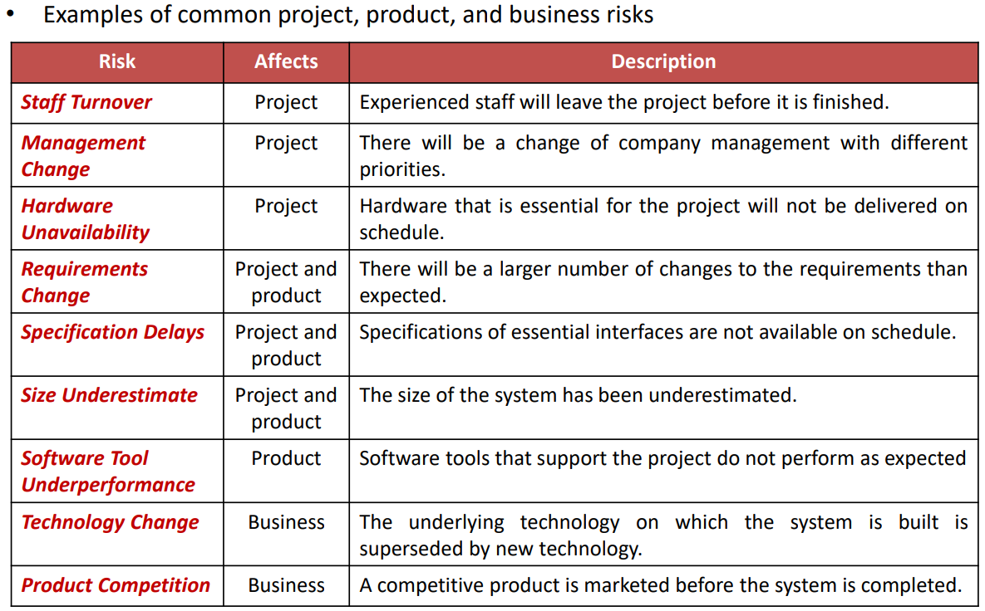

Slide 9
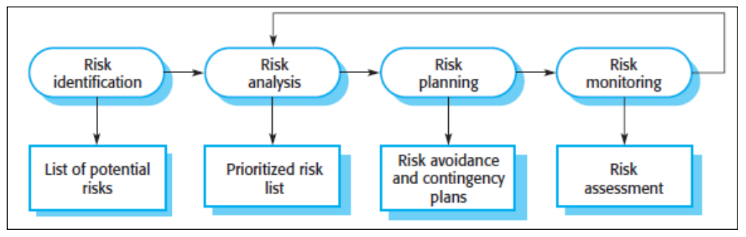
Risk Management Process

Slide 10
Risk Identification
Risk identification is a systematic attempt to specify threats to the project plan (estimates, schedule, resource loading, etc.).
By identifying known and predictable risks, the project manager takes a first step toward avoiding them when possible and controlling them when necessary.
Generic risks are a potential threat to every software project.
Product-specific risks can be identified only by those with a clear understanding of the technology, the people, and the environment that is specific to the project at hand.
To identify product-specific risks, the project plan and the software statement of scope are examined and an answer to the following question is developed: "What special characteristics of this product may threaten our project plan?

Slide 11
Generic Risk Identification
The checklist can be used for risk identification and focuses on some subset of known and predictable risks in the following generic subcategories:
Product size: risks associated with the overall size of the software to be built or modified.
Business impact: risks associated with constraints imposed by management or the marketplace.
Customer characteristics: risks associated with the sophistication of the customer and the developer's ability to communicate with the customer in a timely manner.
Process definition: risks associated with the degree to which the software process has been defined and is followed by the development organization.
Development environment: risks associated with the availability and quality of the tools to be used to build the product.
Technology to be built: risks associated with the complexity of the system to be built and the "newness" of the technology that is packaged by the system.
Staff size and experience: risks associated with the overall technical and project experience of the software engineers who will do the work

Slide 12
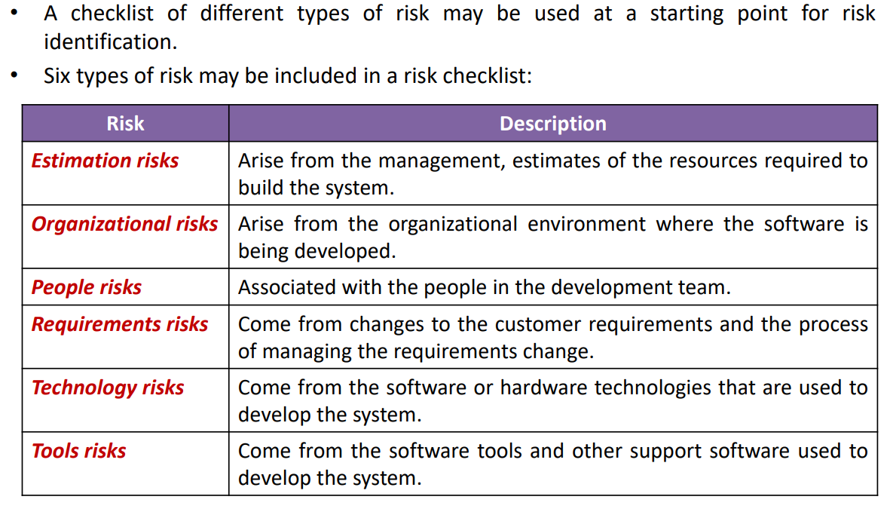

Slide 13
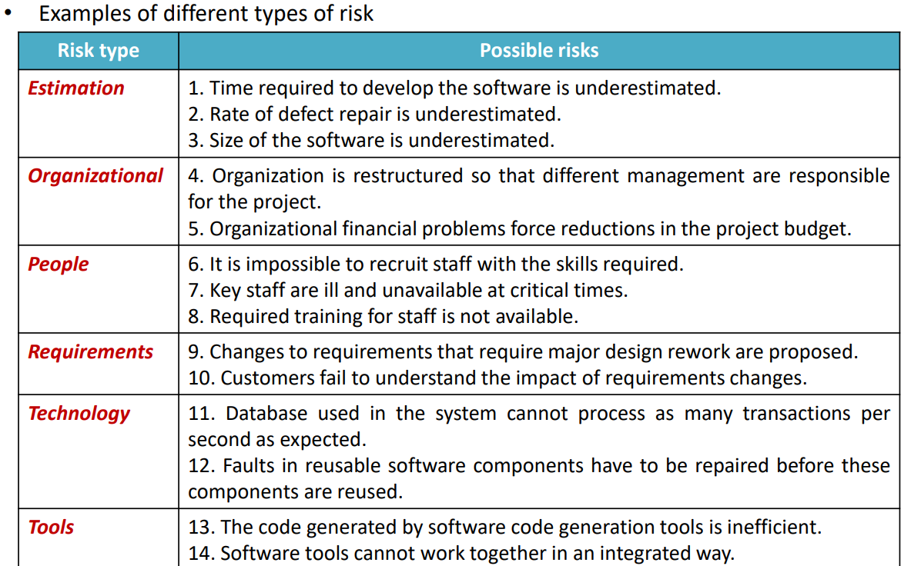

Slide 14
Risk Analysis
During the risk analysis process, you have to consider each identified risk and make a judgment about the probability and seriousness of that risk.
Risk can be assigned to any one of a number of bands:
1. The probability of the risk might be assessed as –
Insignificant : Tolerable Risk (No harm)
Low : Minor Effect
Moderate : Impact on time
High : Impact on Time and Budget
Very high : Impact on Output time, Budget and Performance
2. The effects of the risk might be assessed as
Catastrophic (threaten the survival of the project)
Serious (would cause major delays)
Tolerable (delays are within allowed possibility)
Insignificant

Slide 15
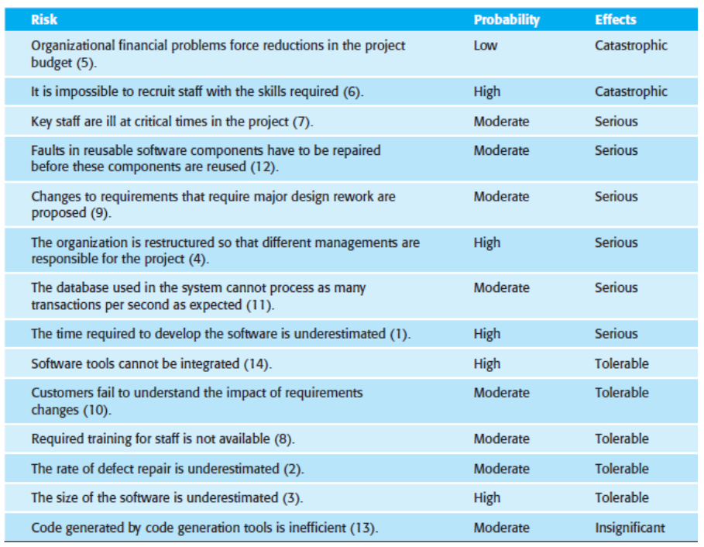

Slide 16
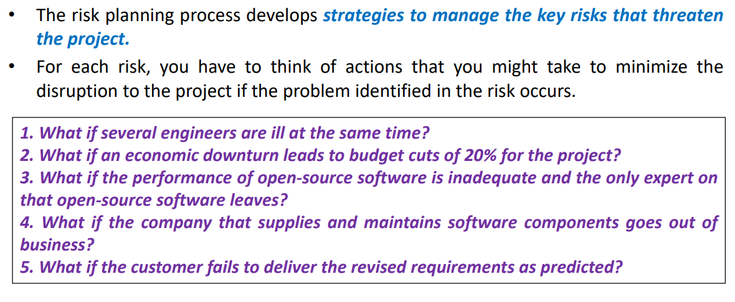
Risk Planning

Slide 17
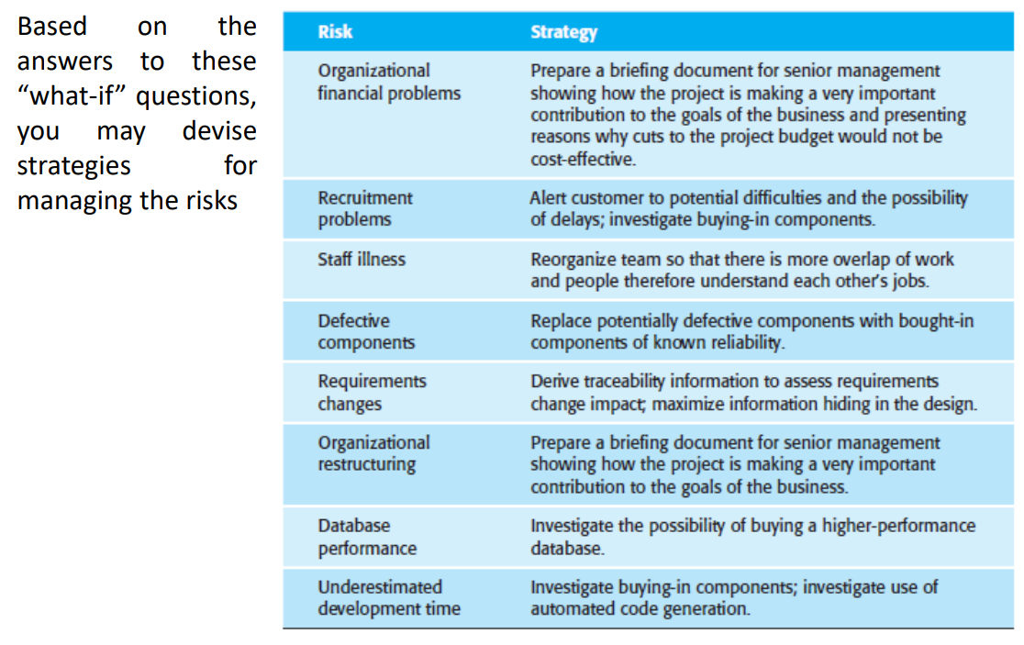

Slide 18
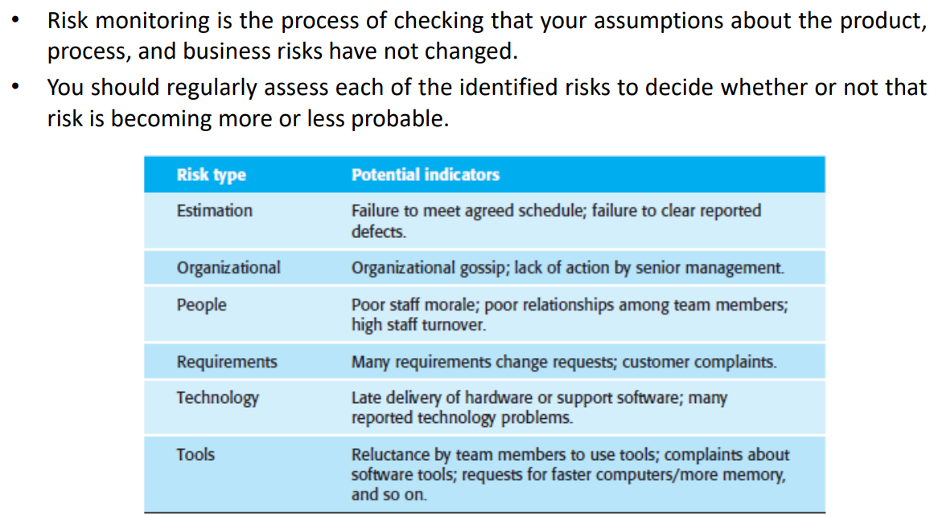
Risk Monitoring

Slide 19
Risk Components
The U.S. Air Force [AFC88] has written a pamphlet that contains excellent guidelines for software risk identification and abatement.
The Air Force approach requires that the project manager identify the risk drivers that affect software risk components—performance, cost, support, and schedule.
In the context of this discussion, the risk components are defined in the following manner:
Performance risk—the degree of uncertainty that the product will meet its requirements and be fit for its intended use.
Cost risk—the degree of uncertainty that the project budget will be maintained.
Support risk—the degree of uncertainty that the resultant software will be easy to correct, adapt, and enhance.
Schedule risk—the degree of uncertainty that the project schedule will be maintained and that the product will be delivered on time

Slide 20
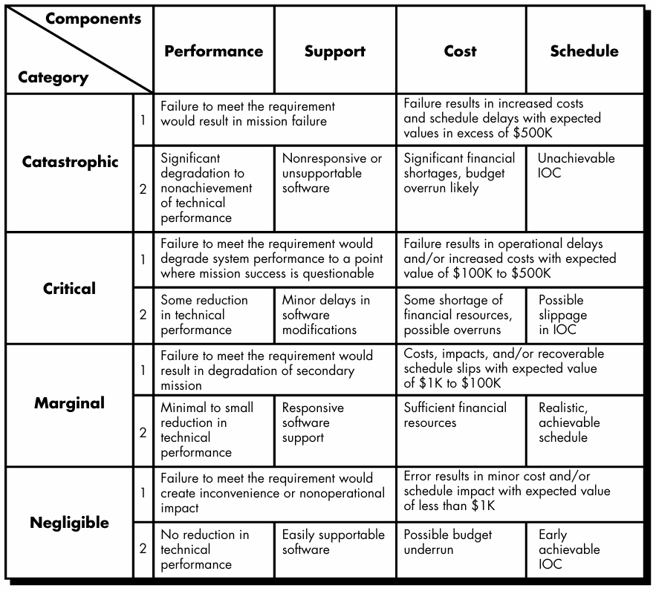
Impact Assessment

Slide 21
Risk Projection
Risk projection, also called risk estimation, attempts to rate each risk in two ways—the likelihood or probability that the risk is real and the consequences of the problems associated with the risk, should it occur.
The project planner, along with other managers and technical staff, performs four risk projection activities:
(1) establish a scale that reflects the perceived likelihood of a risk,
(2) delineate the consequences of the risk,
(3) estimate the impact of the risk on the project and the product, and
(4) note the overall accuracy of the risk projection so that there will be no misunderstandings.

Slide 22
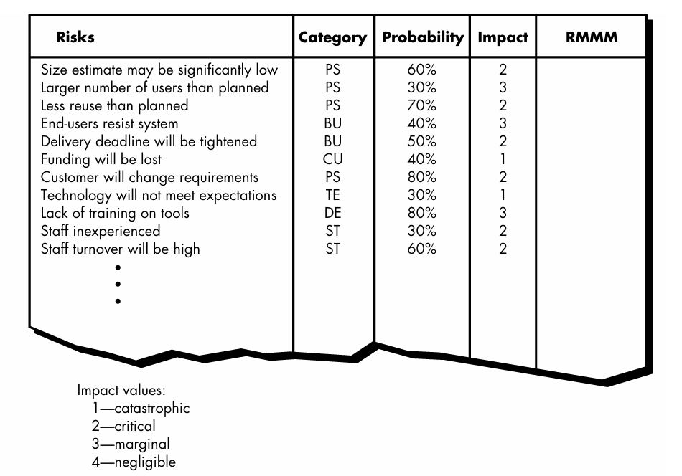
Risk Table

Slide 23
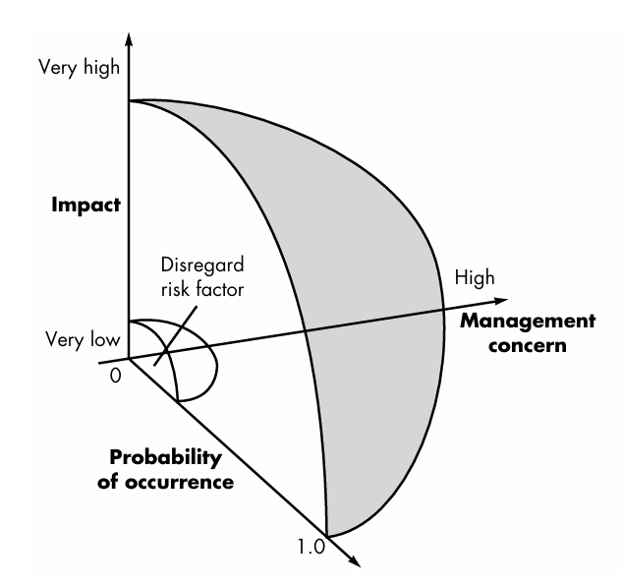
Risk and Management Concern

Slide 24
Assessing the Risk Impact
Three factors affect the consequences that are likely if a risk does occur: its nature, its scope, and its timing.
The nature of the risk indicates the problems that are likely if it occurs.
For example, a poorly defined external interface to customer hardware (a technical risk) will preclude early design and testing and will likely lead to system integration problems late in a project.
The scope of a risk combines the severity (just how serious is it?) with its overall distribution (how much of the project will be affected or how many customers are harmed?).
Finally, the timing of a risk considers when and for how long the impact will be felt.
The overall risk exposure, RE, is determined using the following relationship [HAL98]: RE = P x C
where P is the probability of occurrence for a risk, and C is the the cost to the project should the risk occur

Slide 25
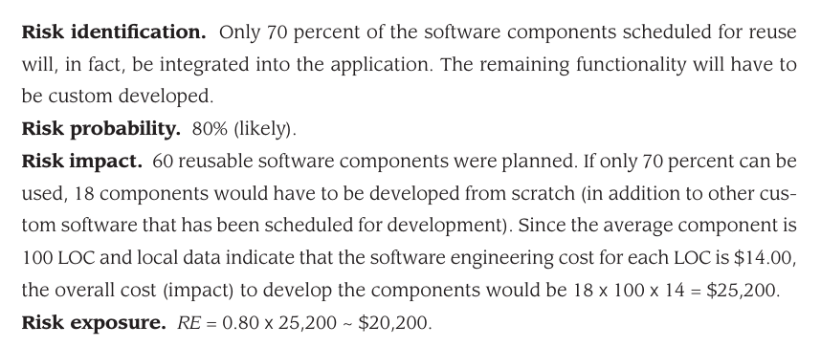

Slide 26
RISK MITIGATION, MONITORING, AND MANAGEMENT (RMMM Plan)
A risk management strategy can be included in the software project plan or the risk management steps can be organized into a separate Risk Mitigation, Monitoring and Management Plan.
All of the risk analysis activities presented to this point have a single goal—to assist the project team in developing a strategy for dealing with risk.
An effective strategy must consider three issues:
risk avoidance
risk monitoring
risk management and contingency planning

Slide 27
Risk Mitigation
It is an activity used to avoid problems (Risk Avoidance).
Steps for mitigating the risks as follows.
Finding out the risk.
Removing causes that are the reason for risk creation.
Controlling the corresponding documents from time to time.
Conducting timely reviews to speed up the work.

Slide 28
Risk Monitoring
It is an activity used for project tracking.
It has the following primary objectives as follows.
To check if predicted risks occur or not.
To ensure proper application of risk aversion steps defined for risk.
To collect data for future risk analysis.
To allocate what problems are caused by which risks throughout the project.

Slide 29
Risk Management and planning
It assumes that the mitigation activity failed and the risk is a reality.
This task is done by Project manager when risk becomes reality and causes severe problems.
If the project manager effectively uses project mitigation to remove risks successfully then it is easier to manage the risks.
This shows that the response that will be taken for each risk by a manager.
The main objective of the risk management plan is the risk register.
This risk register describes and focuses on the predicted threats to a software project.

Slide 30
RMMM for high staff turnover?

Slide 31
Risk Mitigation:
To mitigate this risk, project management must develop a strategy for reducing turnover. The possible steps to be taken are:
Meet the current staff to determine causes for turnover (e.g., poor working conditions, low pay, competitive job market).
Mitigate those causes that are under our control before the project starts.
Once the project commences, assume turnover will occur and develop techniques to ensure continuity when people leave.
Organize project teams so that information about each development activity is widely dispersed.
Define documentation standards and establish mechanisms to ensure that documents are developed in a timely manner.
Assign a backup staff member for every critical technologist.
Risk Monitoring:
As the project proceeds, risk monitoring activities commence. The project manager monitors factors that may provide an indication of whether the risk is becoming more or less likely. In the case of high staff turnover, the following factors can be monitored:
General attitude of team members based on project pressures.
Interpersonal relationships among team members.
Potential problems with compensation and benefits.
The availability of jobs within the company and outside it.

Slide 32
Risk Management:
Risk management and contingency planning assumes that mitigation efforts have failed and that the risk has become a reality.
Continuing the example, the project is well underway, and a number of people announce that they will be leaving.
If the mitigation strategy has been followed, backup is available, information is documented, and knowledge has been dispersed across the team.
In addition, the project manager may temporarily refocus resources (and readjust the project schedule) to those functions that are fully staffed, enabling newcomers who must be added to the team to “get up to the speed“.
Drawbacks of RMMM:
It incurs additional project costs.
It takes additional time.
For larger projects, implementing an RMMM may itself turn out to be another tedious project.
RMMM does not guarantee a risk-free project, infact, risks may also come up after the project is delivered.

Slide 33
